Slide 1
Week 3 Review
Sorry I’m not there in person

Slide 2
Previously, in IMM120
Long term projects
Bracket placement
Functions
Collision Examples
Explain the math better

Slide 3
Long Term Projects
Midterm (2 weeks starting October 22 [day after break])
Final Project (3 weeks starting November 25)

Slide 4
Bracket Placement
Code between two braces is called a { block }.
You’ll need a block of code when you:
Use a function (setup, draw, custom)
Use an if statement: if (true?) { code block } else { code block }
Code blocks are normally indented in properly formatted code.
Code blocks end at the } and all variables made inside are gone.

Slide 5
Functions
Next week: custom functions
mouseX, mouseY ellipse(x, y, diameter)
function pointCircle(px,py, cx,cy,d) {

Slide 6
Collision Detection
https://crhallberg.com/CollisionDetection/Website

Slide 7
Collision: Point-Circle

Slide 8
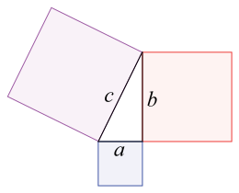
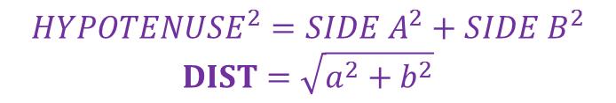
Collision: Point-Circle
DISTANCE
RADIUS
$$HYPOTENUSE^{2}=SIDE A^{2}+SIDE B^{2}$$
$$DIST=\sqrt{a^{2}+b^{2}}$$

Slide 9
Collision: Point-Rectangle
mouseX, mouseY rect(x, y, width, height)
function pointRect(px,py, rx,ry,rw,rh) {

Slide 10
Collision: Point-Rectangle

Slide 11
Examples Available
https://editor.p5js.org/crhallberg/sketches

